Slide 1

INSURING SMILES: PREDICTING ROUTINE DENTAL COVERAGE WITH ML ALGORITHMS
TEAM : AISHWARYA GUPTA
PRIYANKA THOTA
RAHUL BHOGALE
PRATHYUSH KUMAR

Slide 2
AGENDA
INTRODUCTION
PROB STATEMENT
ABOUT THE DATASET ; FEATURES
HADOOP CONFIGURATION
LOADING AND CLEANING (PRE-PROCESSING) OF DATASET
DEFINING PIPELINE
BUILDING THE MODELS
EVALUATING METRICS AND COMPARING ALGORITHMS
CONCLUSION

Slide 3
INTRODUCTION
In this presentation, we will discuss the possibility of predicting whether a given health insurance plan covers routine dental services for adults or not, based on the provided data columns. The primary objective of this study is to explore the feasibility of using machine learning algorithms to classify health insurance plans based on their coverage for routine dental services.
To achieve this, we will use four different classification algorithms: Logistic Regression, Decision Tree, Random Forest, and Support Vector Machine. Each of these algorithms has its strengths and weaknesses, and we will compare their performance to determine which one is the most accurate in predicting dental coverage in health insurance plans.
By predicting dental coverage in health insurance plans, we hope to provide valuable insights that can help both insurance providers and policyholders make more informed decisions about their health coverage options.

Slide 4

PROBLEM STATEMENT
Finding appropriate health insurance coverage can be a challenge for individuals and small enterprises in the USA. However, the Centers for Medicare & Medicaid Services (CMS) has made available a large dataset, the Health Insurance Exchange Public Use Files (Exchange PUFs), that contains information on health and dental policies provided to individuals and small enterprises in the USA. This dataset can be leveraged to support timely benefits, rate analysis, copayments, premiums, and geographic coverage analysis for our data analysis.
In this presentation, we will focus on the use of machine learning algorithms to predict whether a given health insurance plan covers routine dental services for adults or not, based on the CMS dataset. We aim to provide a clinical strategy that allows individuals and families to navigate through various healthcare insurance plans and choose the most appropriate one based on their income and expenses.
By analyzing the data columns such as plan type, region, deductibles, out-of-pocket maximums, and copayments, among others, we will use four different classification algorithms: Logistic Regression, Decision Tree, Random Forest, and Support Vector Machine. These algorithms will help us to predict whether a given health insurance plan covers routine dental services for adults or not.

Slide 5
ABOUT THE DATASET
GITHUB link: https://github.com/rahulbhogale
Dataset link : https://www.cms.gov/cciio/resources/data-resources/marketplace-puf
Dataset Size: 2.1GB

Slide 6
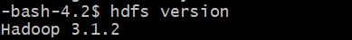
HADOOP CONFIGURATION
VERSION:
NUMBER OF NODES:
FILESYSTEM:

Slide 7
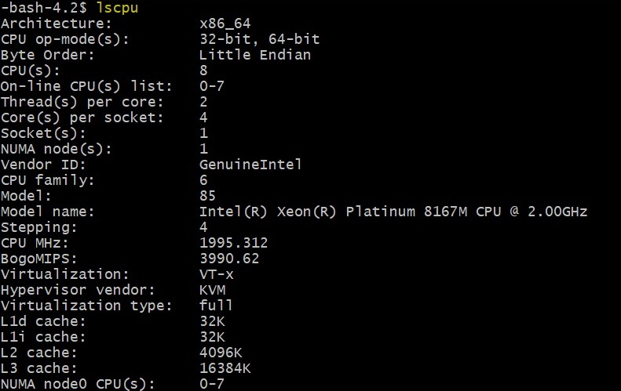

CPU CONFIGURATION AND FILE LOCATION

Slide 8
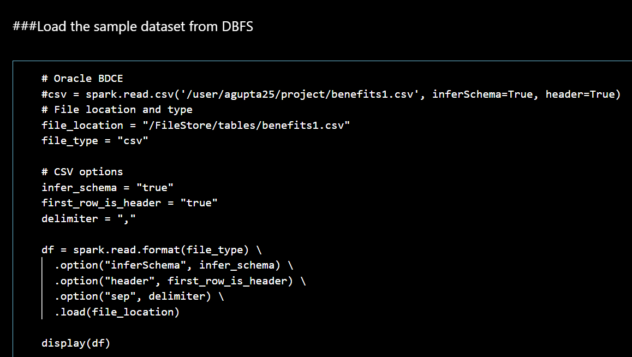
LOADING AND CLEANING OF DATA
STEP ONE: Is to upload a sample dataset with 50,000 rows onto DBFS.

Slide 9
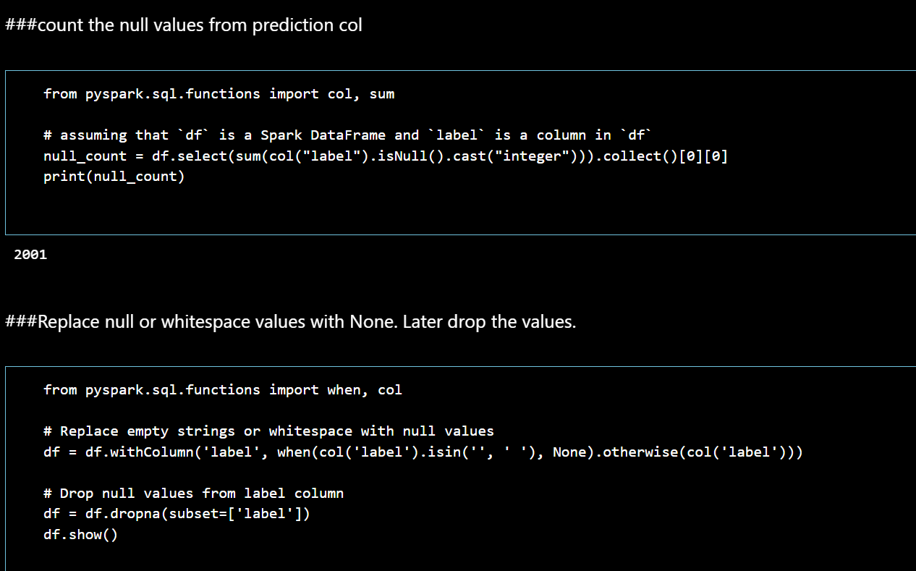
Once the dataset is uploaded, we can read it from the DBFS file system.
Next, we need to identify all the null values in the dataset and remove them. This can be done by aggregating all the null values and dropping the null values.

Slide 10
DEFINE PIPELINE
A pipeline consists of a a series of *transformer* and *estimator* stages that typically prepare a DataFrame for
modeling and then train a predictive model. In this case, you will create a pipeline with seven stages:
- A **StringIndexer** estimator that converts string values to indexes for categorical features
- A **VectorAssembler** that combines categorical features into a single vector
- A **VectorIndexer** that creates indexes for a vector of categorical features
- A **VectorAssembler** that creates a vector of continuous numeric features
- A **MinMaxScaler** that normalizes continuous numeric features
- A **VectorAssembler** that creates a vector of categorical and continuous features
- A **DecisionTreeClassifier** that trains a classification model.
A predictive model often requires multiple stages of feature preparation. For example, it is common when using some algorithms to distingish between continuous features (which have a calculable numeric value) and categorical features (which are numeric representations of discrete categories). It is also common to *normalize* continuous numeric features to use a common scale (for example, by scaling all numbers to a proportinal decimal value between 0 and 1).

Slide 11
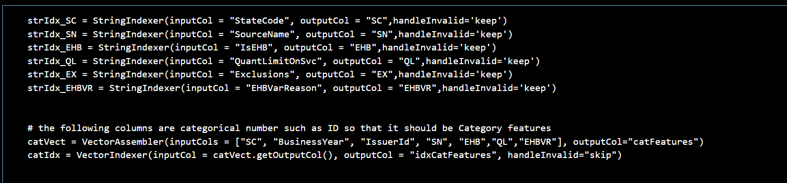
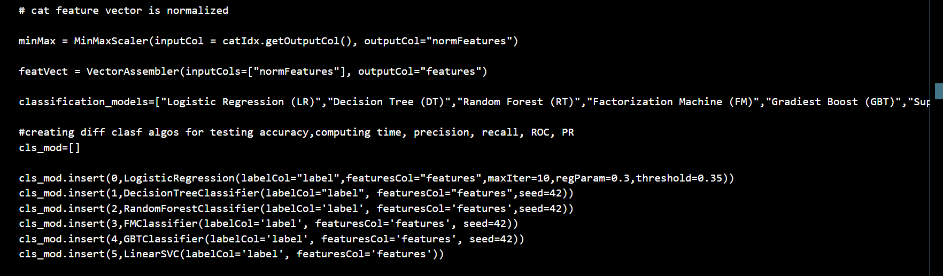
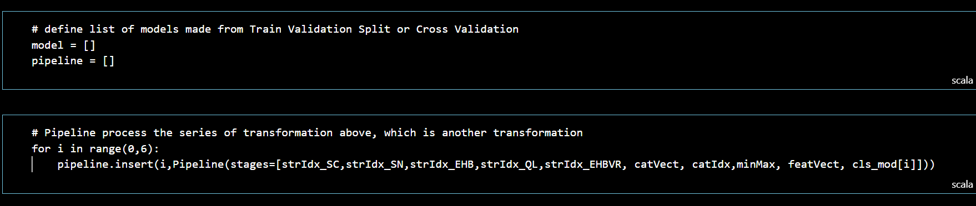

Slide 12
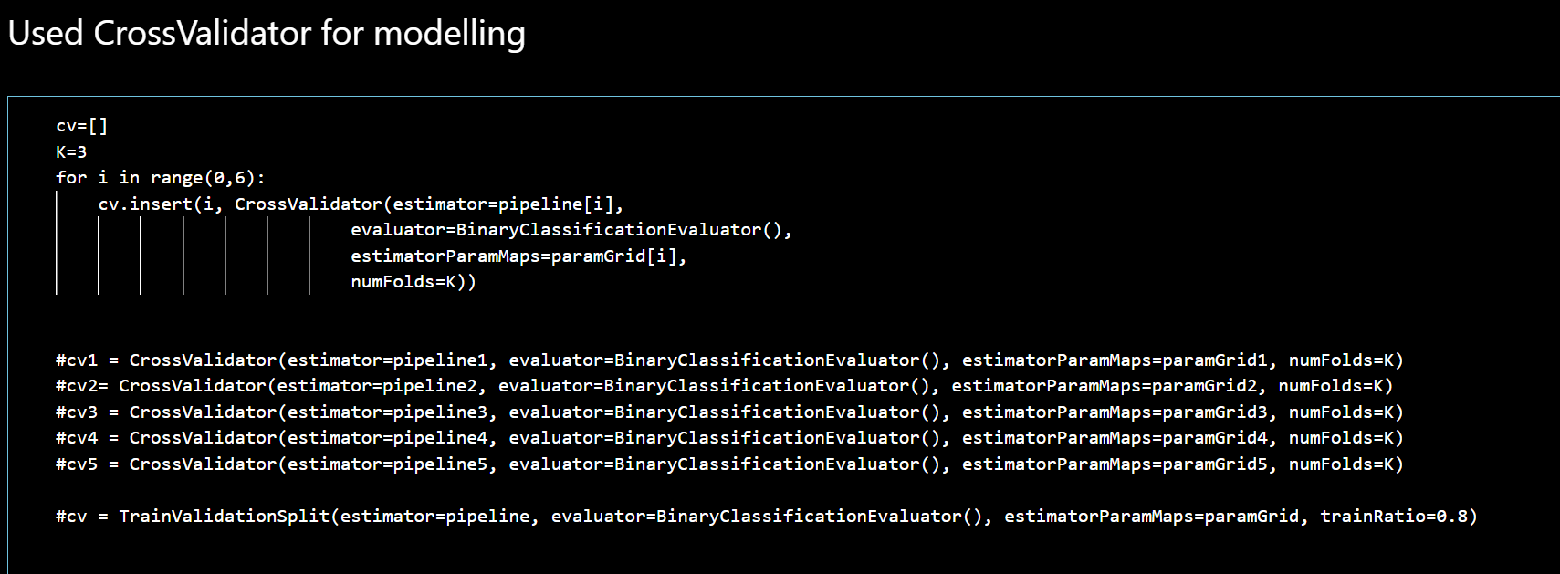
BUILDING THE MODELS
In machine learning, cross-validation is often used to tune model hyperparameters and to compare the performance of different models. There are several methods for implementing cross-validation, including k-fold cross-validation and leave-one-out cross-validation. The choice of method depends on the size of the dataset, the complexity of the model, and other factors.
Using cross-validation can help prevent overfitting, which occurs when a model fits the training data too closely and does not generalize well to new data. By evaluating the model on multiple subsets of the data, cross-validation provides a more accurate estimate of how well the model will perform on new, unseen data.

Slide 13
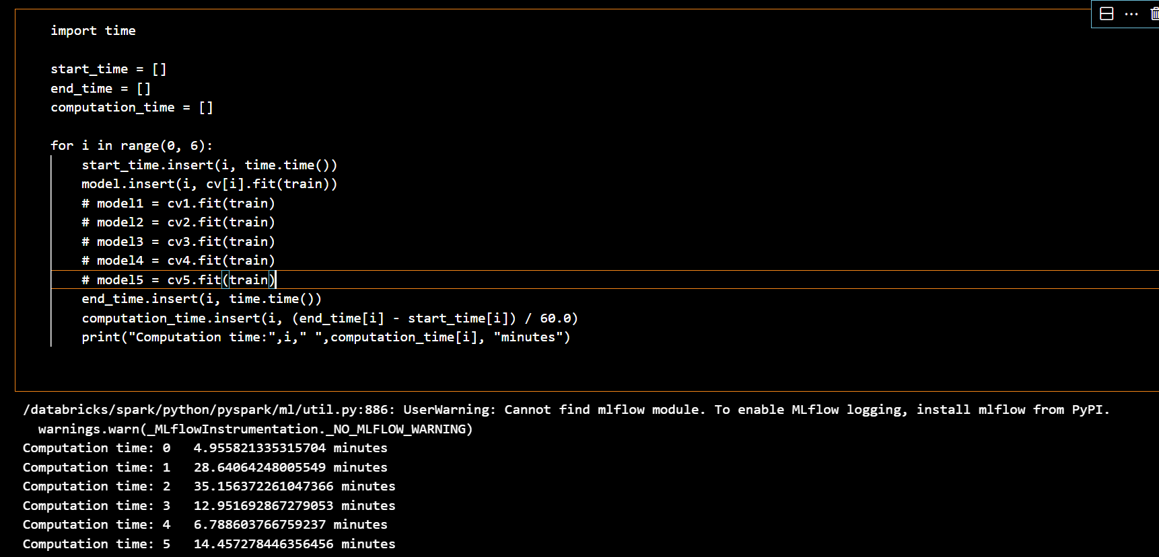
Calculating the computing time required for the model

Slide 14
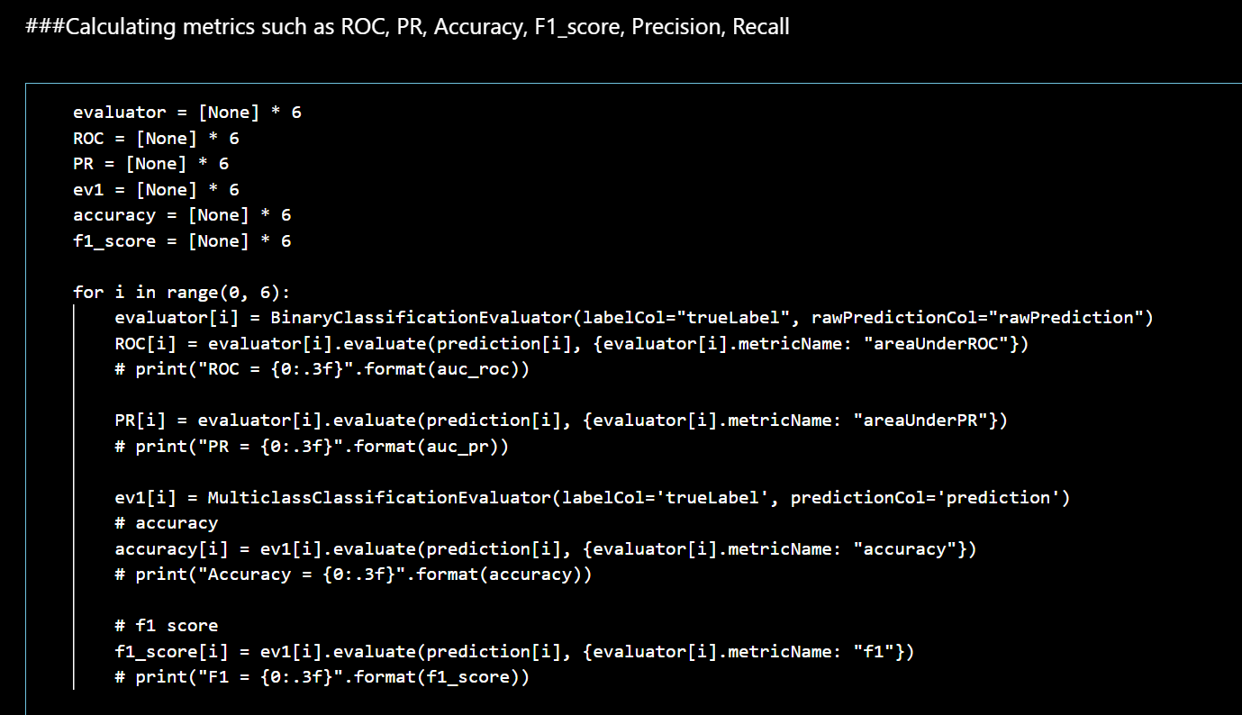
EVALUATING THE METRICS: ROC, PR, ACCURACY, F1_SCORE, PRECISON AND RECALL
When evaluating the performance of a classification model in big data science, it is important to consider multiple metrics such as ROC, PR, accuracy, F1-score, precision, and recall. Each of these metrics provides different insights into the model's performance and helps in understanding its strengths and weaknesses. The choice of metric(s) depends on the specific use case and the desired trade-offs between false positives and false negatives.

Slide 15
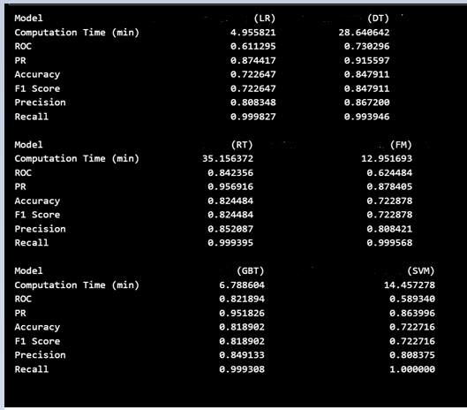
COMPARING ALL THE METRICS AT ONE PLACE (sample dataset)
LR: Logistic regression
DT: Decision Tree
RT: Random Forrest
FM: Factorization Machine
GBT: Gradient Boost
SVM: Support Vector Machine

Slide 16
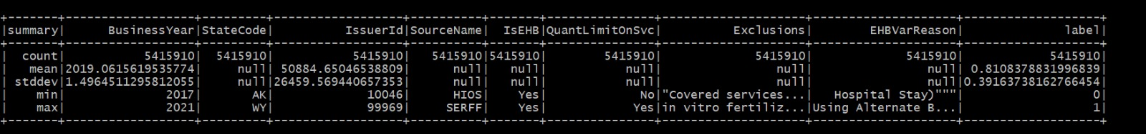
Using Pyspark CLI – Dataset description

Slide 17
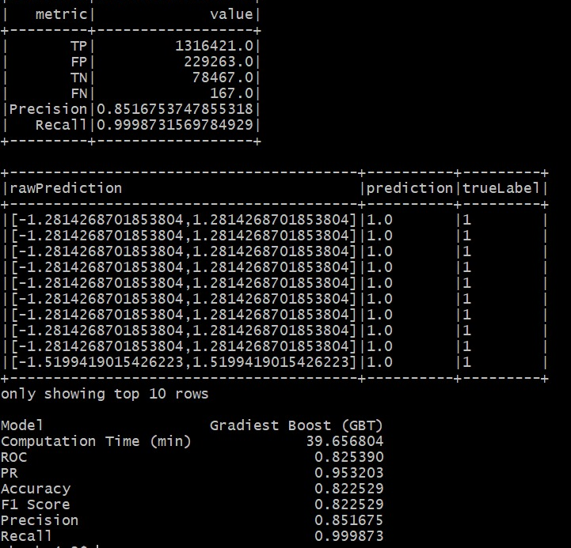
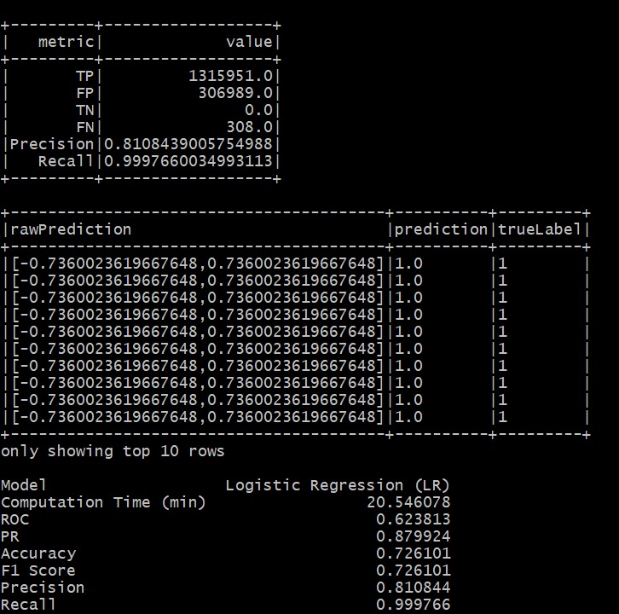
Evaluated Metrics of PySpark CLI

Slide 18
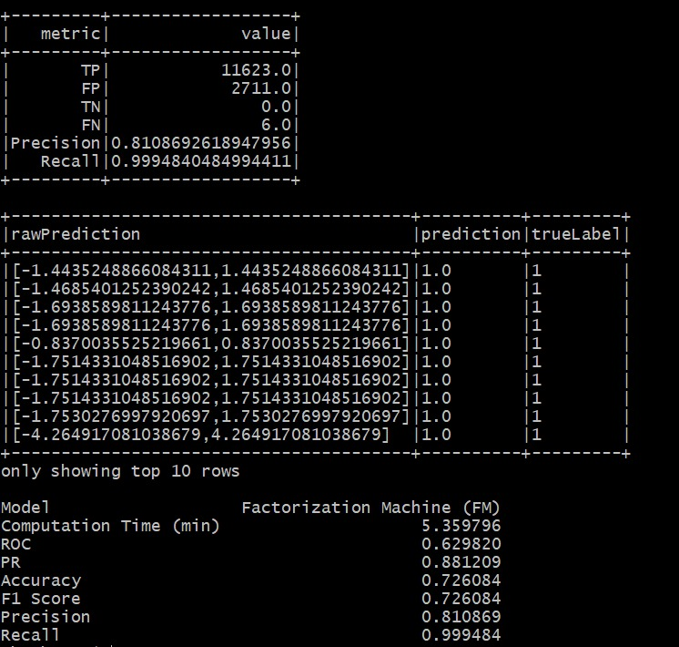
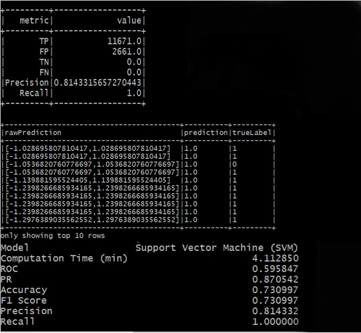

Slide 19
CONCLUSION-1
The best model is Gradient Boost with computation time - 6.5 minutes and accuracy with 83% (sample dataset)
COMPUTATION TIME | ACCURACY | ALGORITHM
5 MINUTES | 72% | LOGISTIC REGRESSION
30 MINUTES | 84% | DECISION TREE
6.5 MINUTES | 83% | GRADIENT BOOST

Slide 20
CONCLUSION -2
The best model is Gradient Boost with computation time - 40 minutes and accuracy with 82% (actual dataset)
COMPUTATION TIME | ACCURACY | ALGORITHM
4 MINUTES | 73% | SUPPORT VECTOR MACHINE
40 MINUTES | 82% | GRADIENT BOOST
5 MINUTES | 73% | FACTORIZATION MACHINE

Slide 21
THANKYOU

